Slide 1





SHIPPING OF CHOCOLATES
Presented by Goda Balayogi

Slide 2



INTRODUCTION
The report offers the collection of sales of various chocolates in the global market.
The chocolates are the most consumed and profitable components of food industry. different ranges of chocolates are produced based on the quantity of cocoa.
The chocolates have been sourced as one of the excellent pressure suppressant and anti-ageing food item.
Chocolates demand have increased due to its benefit in cardio vascular diseases

Slide 3


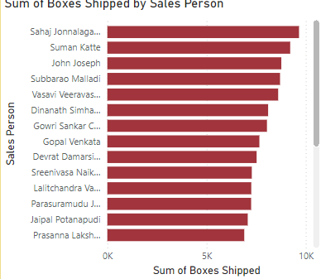
STACKED BAR GRAPH
This graph depicts total number of chocolate boxes shipped individually by the sales person in the global market.
From the graph we get to know that Sajah Jonnalagadda had shipped most of the chocolate boxes across countries when compared to others.

Slide 4
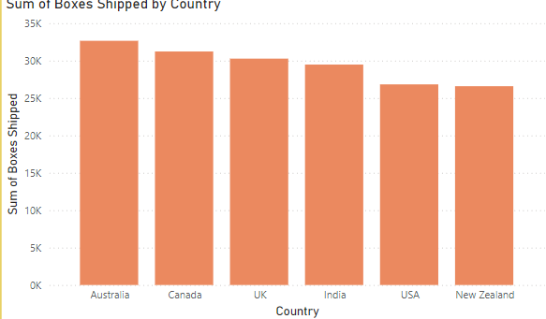
STACKED COLUMN CHART
This column graph gives us the picture of sum of chocolate boxes shipped to the each country.
The Countries are as follows:
a)Australia
b)Canada
c)UK
d)India
e)USA
f)New Zealand

Slide 5
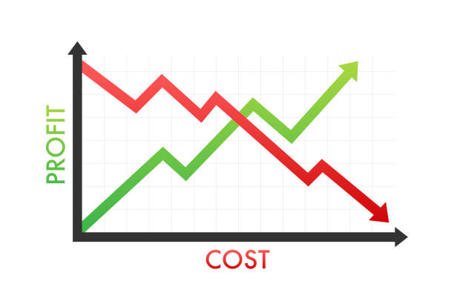
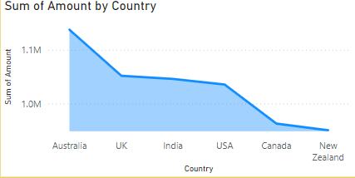
STACKED AREA CHART
In this graph it shows the amount earned from each country by shipping chocolate boxes.
From the graph we get to know that Australia has earned the highest amount and New Zealand the least.

Slide 6

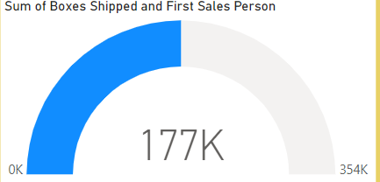
GAUGE
This graph represents the total shipping data.
When we click on each salesperson, it specifies the total number of boxes shipped by that person.

Slide 7


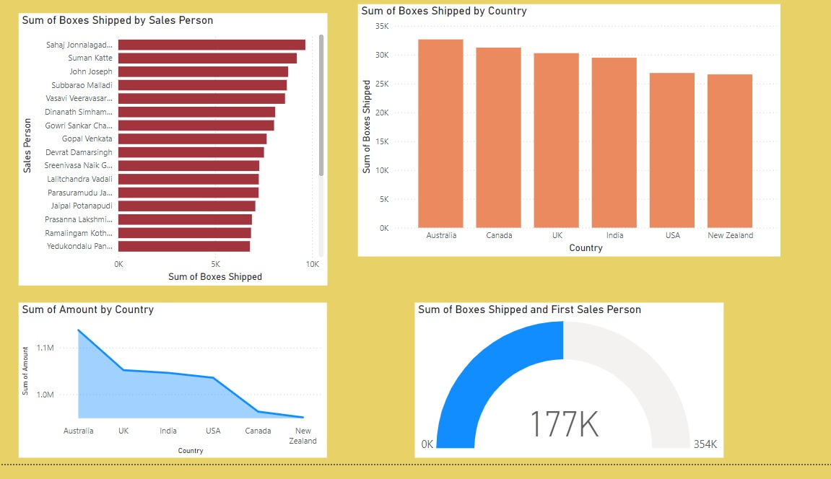
DASHBOARD

Slide 8


